Slide 1
UiPath Studio X Installation
Let’s start RPA with UiPath Studio X

Slide 2

Where to Get UiPath Studio
Move to the uipath official website, https://www.uipath.com
Clicking the “Try UiPath Free” button will open the registration page.

Slide 3
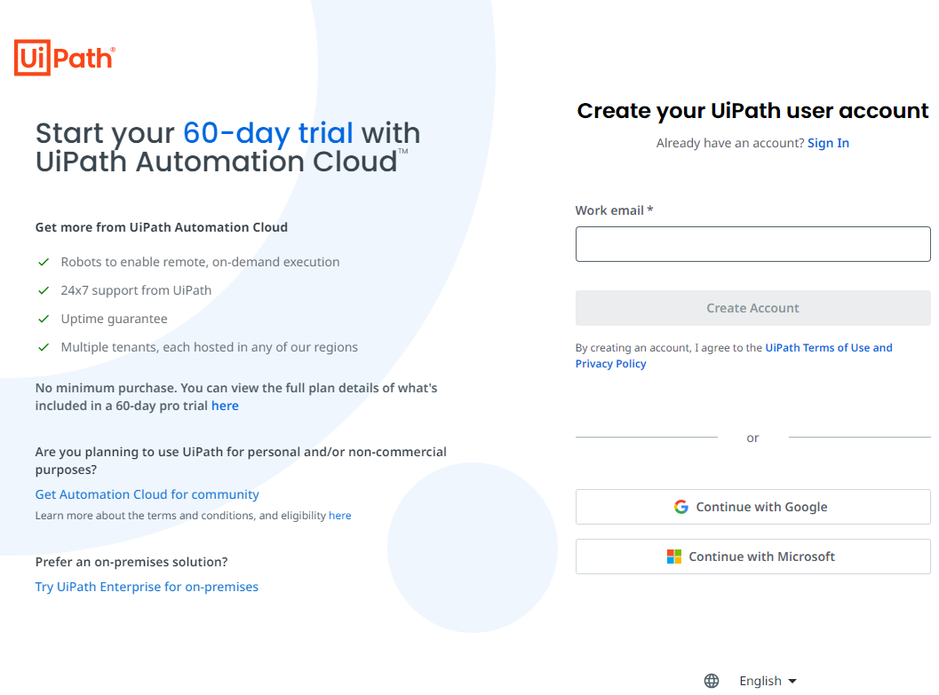
Where to Get UiPath Studio
Continue by clicking the “Get Automation Cloud for Community” link at the bottom.

Slide 4
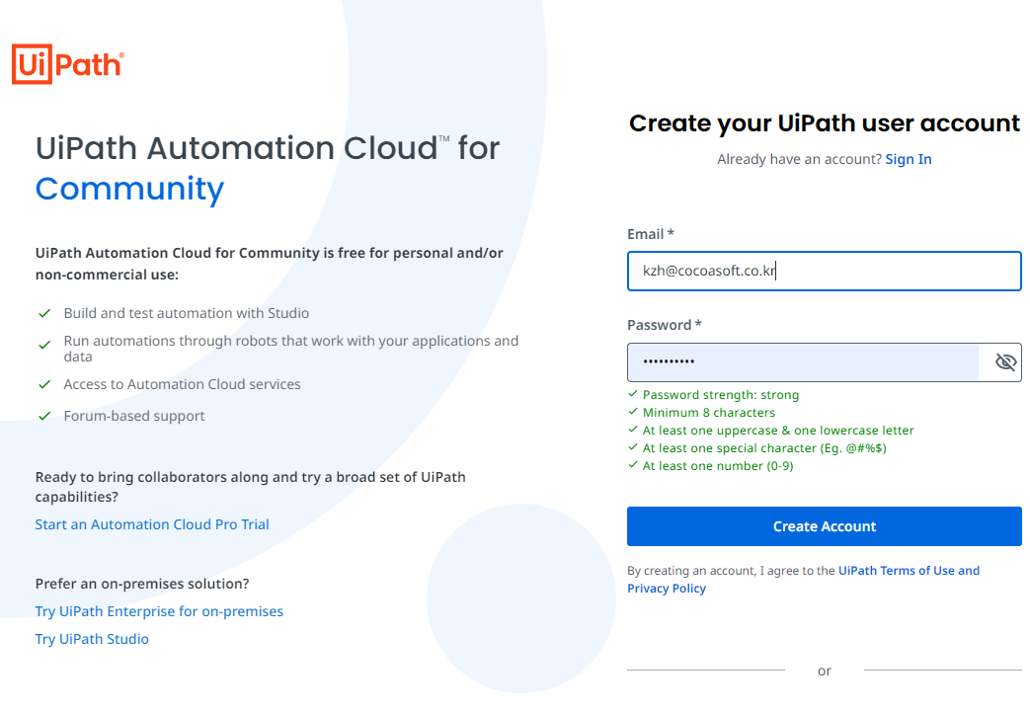
Downloading the installer
Complete the registration to UiPath by entering the email address. After creating the account, you must verify the e-mail.
Then you create your Orchestrator instance after entering some information such as Full Name, Country.

Slide 5
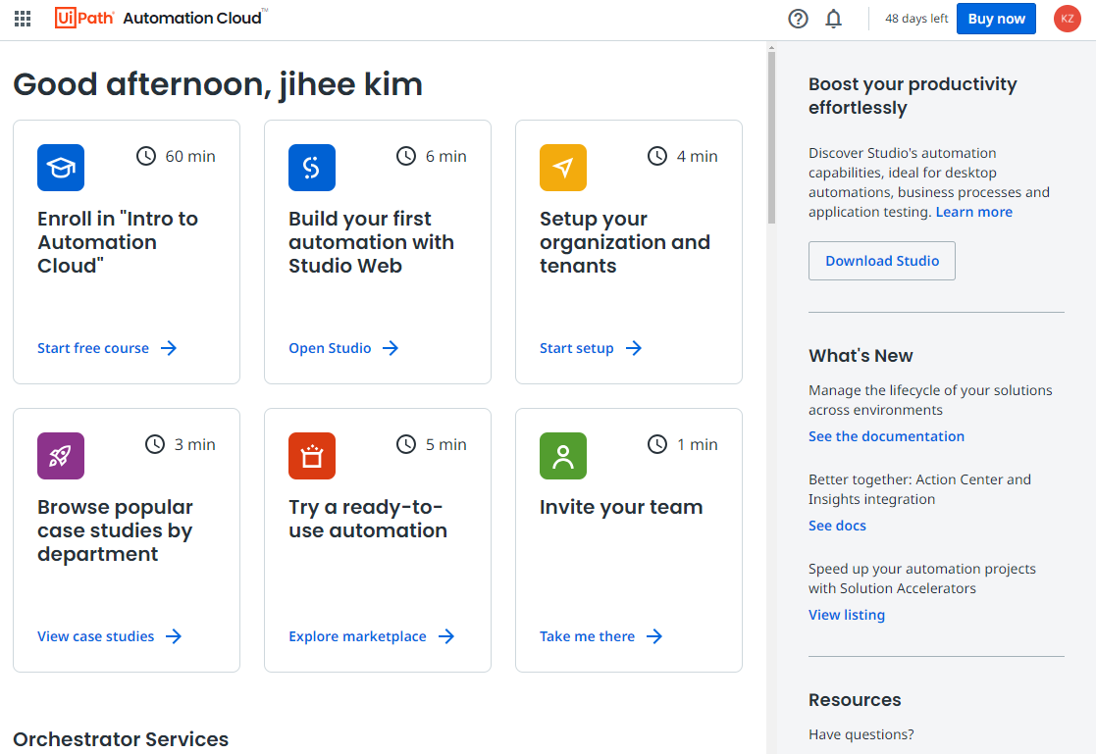
Downloading the installer
The Orchestrator interface appears after creating your Orchestrator instance.
Click the 'Download' button on the right side to download the installer.

Slide 6
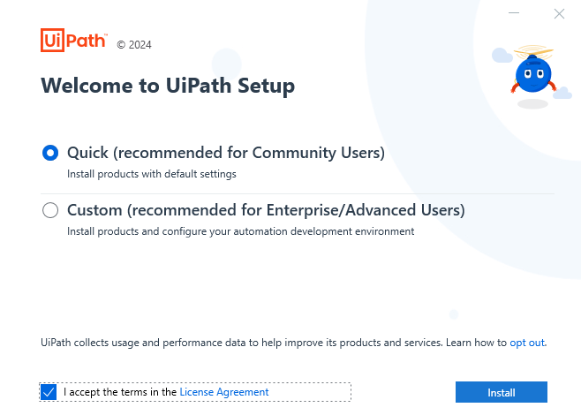
Select Quick Installation
Execute the installer and select ‘Quick Installation’ and check the terms below.
Click the ‘install’ button and wait while the studio installs.

Slide 7
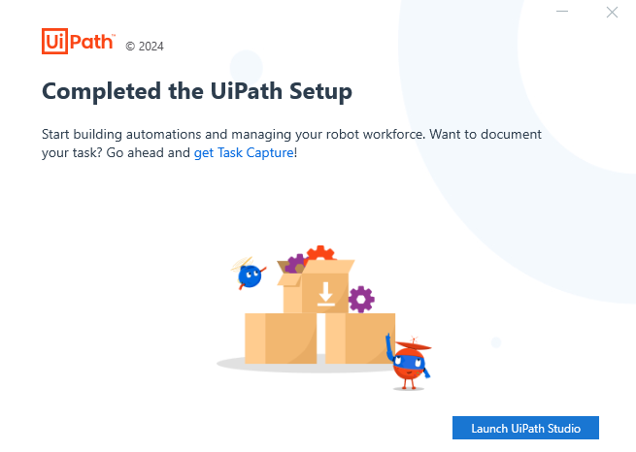
Launch UiPath Studio
Click 'Launch UiPath Studio' to execute the installed program after completing the setup.

Slide 8
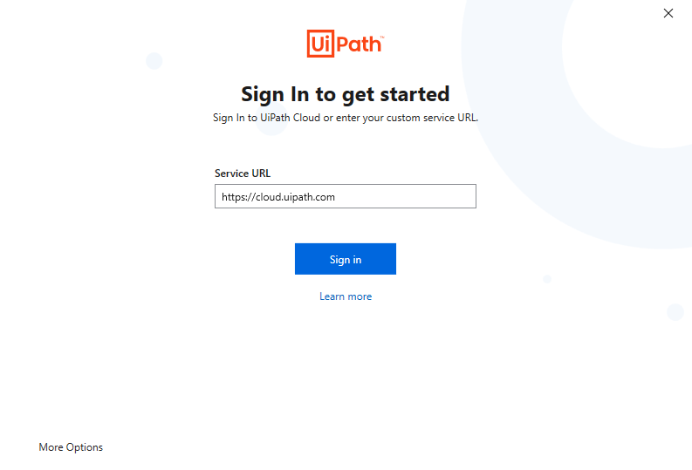
Launch UiPath Studio
Click ‘Sign in' to get started and open Uipath.

Slide 9
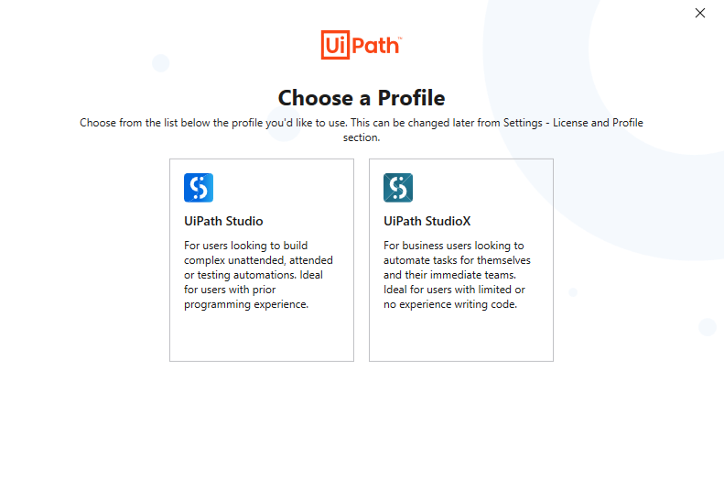
Choose a Profile
Choose ‘UiPath Studio X’ to use studio x.
Then, the installation and setup are completed.

Slide 10
Thank you.
We hope you enjoy your RPA experience with us.

